Slide 1
A Detailed Look in to Energy Consumption and Pollution Related Deaths
Presentation by PollutionSolvers - Zhongyang Hu, Hsueh-Yi Lu, Ali Can Mutlu,

Slide 2
Data Set Information
Data Sets taken from Kaggle
Some Main features: GDP per Capita, Death caused by Indoor Air Pollution per 100,000 people , Death caused by Outdoor Particulate Matter per 100,000 people, Medical Expenditure, Clean Fuel Usage Rate in the Population, Energy Consumption from fuel….
Data Date: 1974-2017
#Observations: +2000

Slide 3
Dataset Summary
data_health: 2.12_Health_systems.csv
Source: Kaggle
Variables:
Country_Region: Qualitative,Categorical Completeness_of_birth_reg_2009-18: Numerical,Continuous
World_Bank_Name : Qualitative,Categorical per_capita_exp_PPP_2016: Numerical,Continuous
Health_exp_pct_GDP_2016 : Numerical,Continuous External_health_exp_pct_2016: Numerical,Continuous
Health_exp_public_pct_2016 : Numerical,Continuous Physicians_per_1000_2009-18: Numerical,Continuous
Health_exp_out_of_pocket_pct_2016 : Numerical,Continuous Nurse_midwife_per_1000_2009-18: Numerical,Continuous
Health_exp_per_capita_USD_2016 : Numerical,Continuous Specialist_surgical_per_1000_2008-18: Numerical,Continuous
Notes:
Our first data set is called “data health”, you can see the features on the slide. (Just mention the red one

Slide 4
Dataset Summary
data_clean: cleanFuelAndTech.csv
Source: Kaggle
Variables:
Location: Qualitative,Categorical
Indicator: Qualitative,Categorical
Period: Numerical, Categorical
First Tooltip: Numerical,Continuous
Notes:
First Tooltip: % of population who use clean fuel at home

Slide 5
Dataset Summary
data_pollution: death-rates-from-air-pollution.csv
Source: Kaggle
Variables:
Entity: Qualitative,Categorical
Code: Qualitative,Categorical
Year: Numerical, Categorical
Air pollution (total) (deaths per 100,000): Numerical,Continuous
Indoor air pollution (deaths per 100,000):Numerical,Continuous
Outdoor particulate matter (deaths per 100,000):Numerical,Continuous
Outdoor ozone pollution (deaths per 100,000):Numerical,Continuous

Slide 6
Dataset Summary
data_GDP: Country_wise_GDP_from_1994_to_2017.csv
Source: Kaggle
Variables:
Country: Qualitative,Categorical Population: Numerical,Continuous
Year: Numerical, Categorical Pop. change (%): Numerical,Continuous
GDP (in USD): Numerical,Continuous GDP Real (in USD):Numerical,Continuous
GDP change (%):Numerical,Continuous
GDP per capita (in USD):Numerical,Continuous

Slide 7
Dataset Summary
data_energy: Percentage_of_Energy_Consumption_by_Country.csv
Source: Kaggle
Variables:
Country: Qualitative,Categorical Hydro Generation – TWh:Numerical,Continuous
Code: Qualitative,Categorical Nuclear Generation – TWh: Numerical,Continuous
Year: Numerical, Categorical Solar Generation – TWh: Numerical,Continuous
Coal Consumption - EJ :Numerical,Continuous Wind Generation –TWh: Numerical,Continuous
Gas Consumption - EJ Numerical,Continuous Oil Consumption – EJ: Numerical,Continuous
Geo Biomass Other - TWh :Numerical,Continuous

Slide 8
Data Pre-Processing
class preprocessing():
def indoor2016(self): df1=self.dfselection(self.setf2,self.data_health,'World_Bank_Name') df2=self.dfselection(self.setf2,self.data_clean,'Location') df3=self.dfselection(self.setf2,self.data_pollution,'Entity') df4=self.dfselection(self.setf2,self.data_GDP,'Country') df2=df2[df2['Period']==2016] df3=df3[df3['Year']==2016] df4=df4[df4['Year']==2016] df1=df1.rename(columns={"World_Bank_Name": "Location"}) df3=df3.rename(columns={'Entity':'Location'}) df4=df4.rename(columns={'Country':'Location'}) out=pd.merge(df1,df2,how='outer',on='Location') out=pd.merge(out,df3,how='outer',on="Location") out=pd.merge(out,df4,how='outer',on='Location') out=out.drop(columns='Province_State') return out
Indoor2016():
Select datasets
Year = 2016
Rename columns
Merge datasets

Slide 9
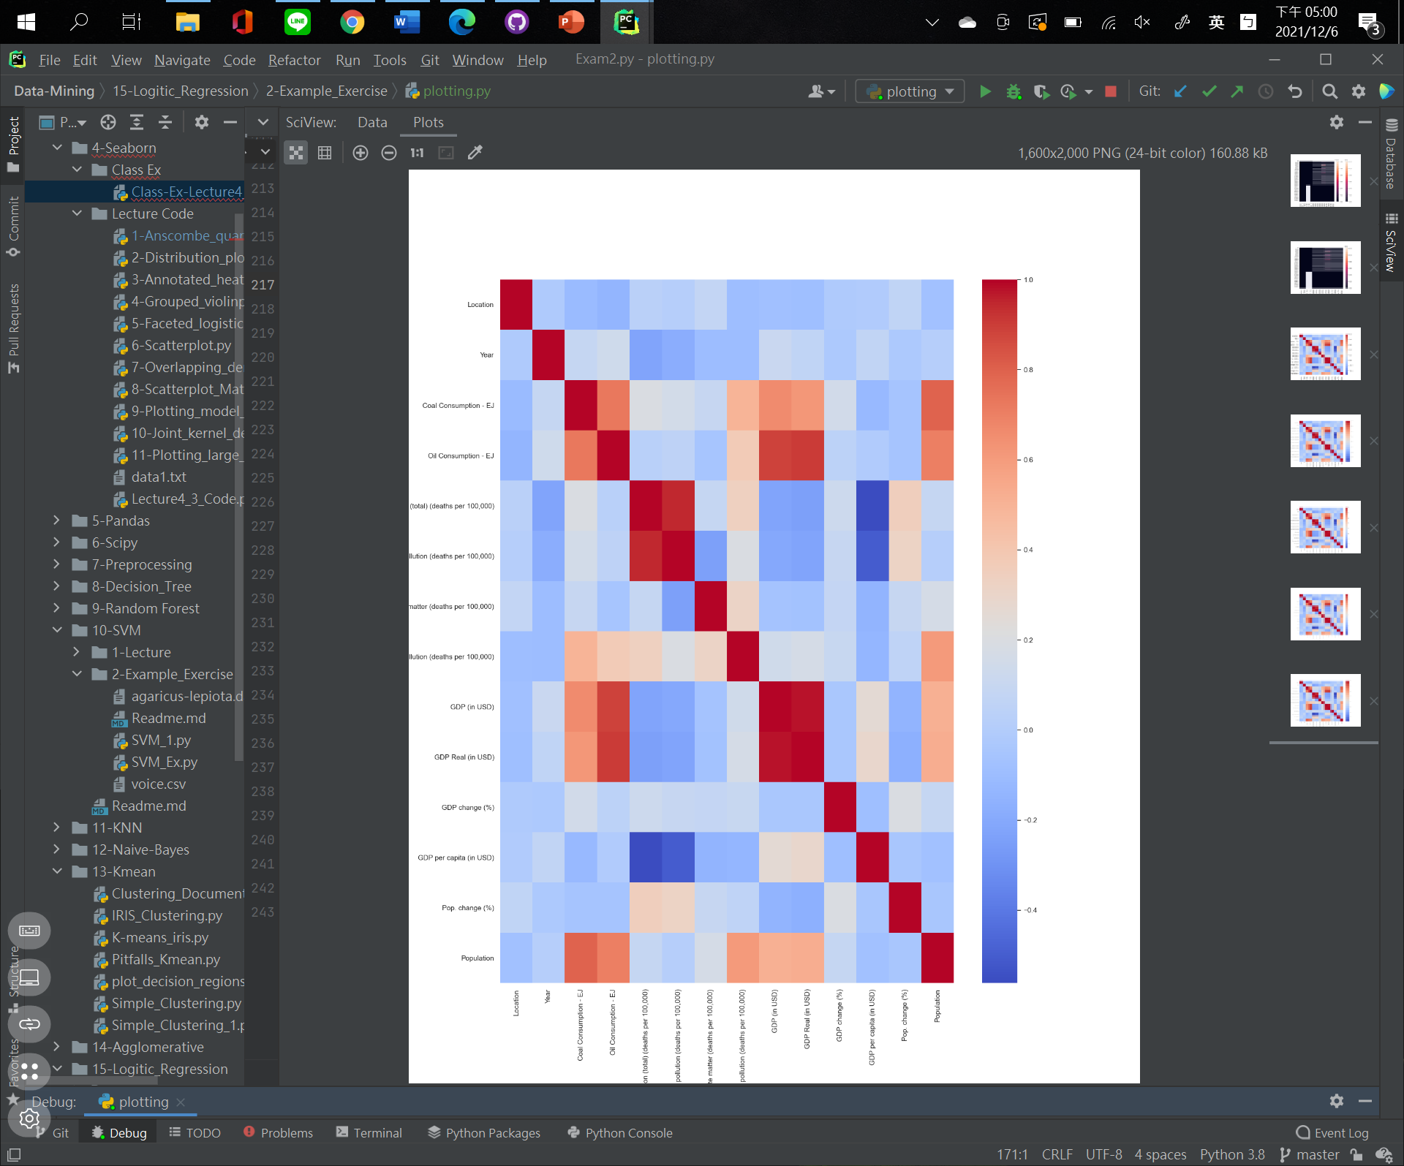

Slide 10
Data Pre-Processing
indoor():
Select datasets
Rename columns
Merge datasets by Location and Year
def indoor(self): df2=self.dfselection(self.setf2,self.data_clean,'Location') df3=self.dfselection(self.setf2,self.data_pollution,'Entity') df4=self.dfselection(self.setf2,self.data_GDP,'Country') df2 = df2.rename(columns={"Period": "Year"}) df3 = df3.rename(columns={'Entity': 'Location'}) df4 = df4.rename(columns={'Country': 'Location'}) out = pd.merge(df2, df3, how='outer', on=['Location','Year']) out = pd.merge(out, df4, how='outer', on=['Location','Year']) return out

Slide 11
Data Pre-Processing
Outdoor():
Select datasets
Rename columns
Merge datasets by Location and Year
def outdoor(self): df3=self.dfselection(self.setf,self.data_pollution,'Entity') df4=self.dfselection(self.setf,self.data_GDP,'Country') df3 = df3.rename(columns={'Entity': 'Location'}) df4 = df4.rename(columns={'Country': 'Location'}) out = pd.merge(df3, df4, how='outer', on=['Location', 'Year']) return out

Slide 12
Data Pre-Processing
def Merge_energy(self): df5 = self.dfselection(self.setf2, self.data_energy, 'Entity') df3 = self.dfselection(self.setf2, self.data_pollution, 'Entity') df4 = self.dfselection(self.setf2, self.data_GDP, 'Country') df3 = df3.rename(columns={'Entity': 'Location'}) df4 = df4.rename(columns={'Country': 'Location'}) df5 = df5.rename(columns={'Entity': 'Location'}) out = pd.merge(df5, df3, how='outer', on=['Location', 'Year']) out = pd.merge(out, df4, how='outer', on=['Location', 'Year']) out = out.drop(columns='Wind Generation -TWh') out = out.drop(columns='Solar Generation - TWh') out = out.drop(columns='Nuclear Generation - TWh') out = out.drop(columns='Hydro Generation - TWh') out = out.drop(columns='Geo Biomass Other - TWh') out = out.drop(columns='Gas Consumption - EJ') return out
Merge_energy():
Select datasets
Rename columns
Merge datasets
Drop unnecessary columns

Slide 13
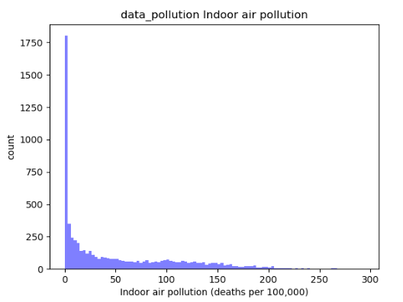
EDA
num_bins = 100 n, bins, patches = plt.hist(dp['Indoor air pollution (deaths per 100,000)'], num_bins, facecolor='blue', alpha=0.5) plt.xlabel('Indoor air pollution (deaths per 100,000)') plt.ylabel('count') plt.title('data_pollution Indoor air pollution') plt.show()

Slide 14
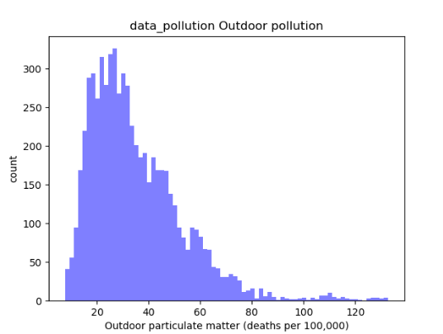
EDA
dp = data_pollution_p num_bins = 75 n, bins, patches = plt.hist(dp['Outdoor particulate matter (deaths per 100,000)'], num_bins, facecolor='blue', alpha=0.5) plt.xlabel('Outdoor particulate matter (deaths per 100,000)') plt.ylabel('count') plt.title('data_pollution Outdoor pollution') plt.show()

Slide 15
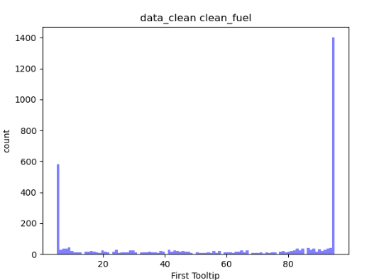
EDA
dc = data_clean_p num_bins = 100 # the histogram of the data n, bins, patches = plt.hist(dc['First Tooltip'], num_bins, facecolor='blue', alpha=0.5) plt.xlabel('First Tooltip') plt.ylabel('count') plt.title('data_clean clean_fuel’) plt.show()

Slide 16
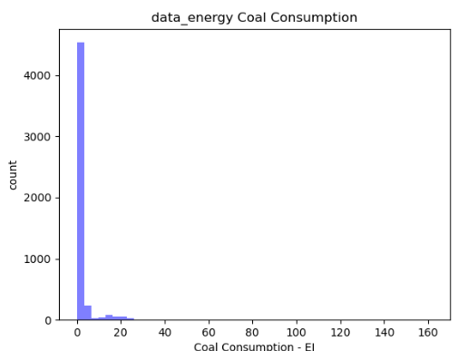
EDA
de = data_energy_p num_bins = 50 n, bins, patches = plt.hist(de['Coal Consumption - EJ'], num_bins, facecolor='blue', alpha=0.5) plt.xlabel('Coal Consumption - EJ') plt.ylabel('count') plt.title('data_energy Coal Consumption') plt.show()

Slide 17
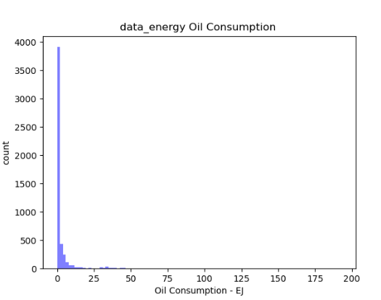
EDA
num_bins = 100 n, bins, patches = plt.hist(de['Oil Consumption - EJ'], num_bins, facecolor='blue', alpha=0.5) plt.xlabel('Oil Consumption - EJ') plt.ylabel('count') plt.title('data_energy Oil Consumption') plt.show()

Slide 18
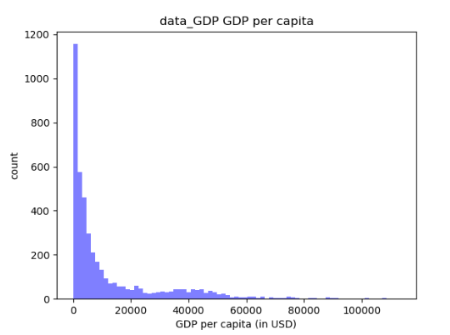
EDA
dg = data_GDP_p num_bins = 75 n, bins, patches = plt.hist(dg['GDP per capita (in USD)'], num_bins, facecolor='blue', alpha=0.5) plt.xlabel('GDP per capita (in USD)') plt.ylabel('count') plt.title('data_GDP GDP per capita') plt.show()

Slide 19
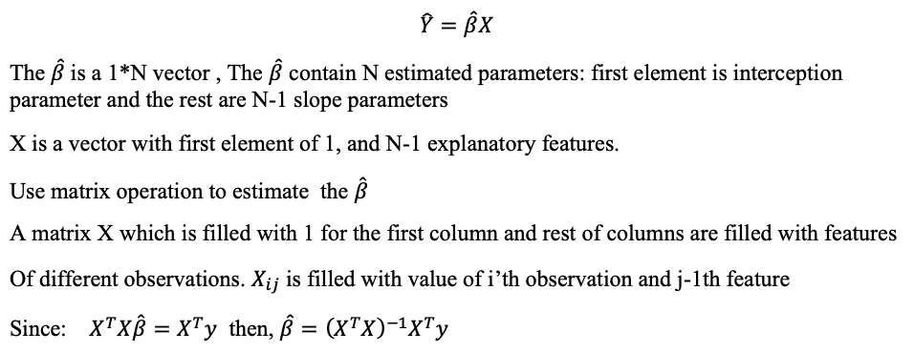
Introduction of the Model

Slide 20
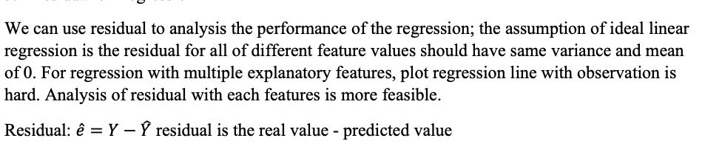
Analysis of the Model

Slide 21
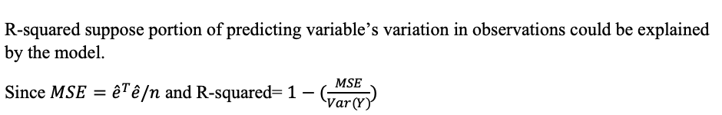
Analysis of the Model

Slide 22
GUI GRAPHS DISPLAY

Slide 23
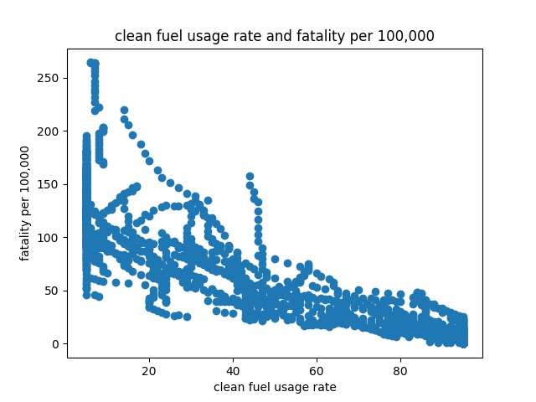

Findings – Basic Model Indoor Pollution

Slide 24
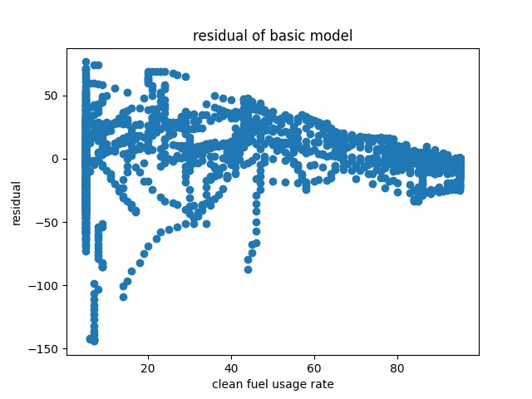

Slide 25
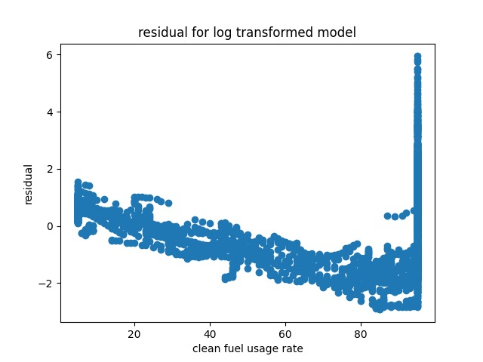
Transform the Model with 1 Feature

Slide 26
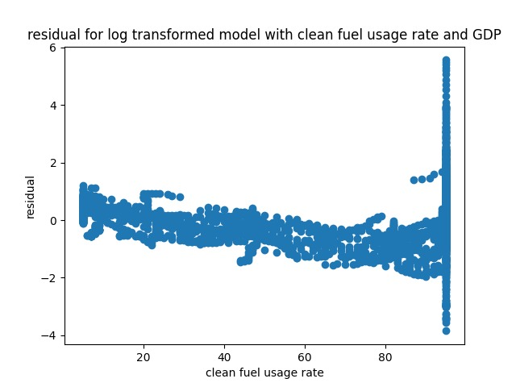
Transform the Model with 2 Features

Slide 27
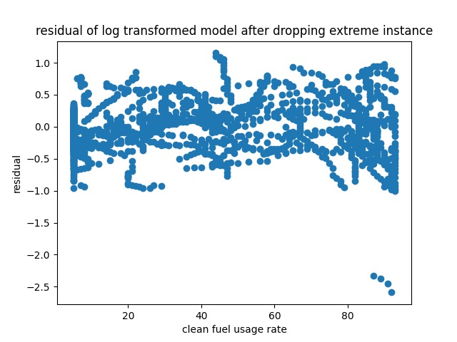
Best Model with R^2 = 0.82

Slide 28
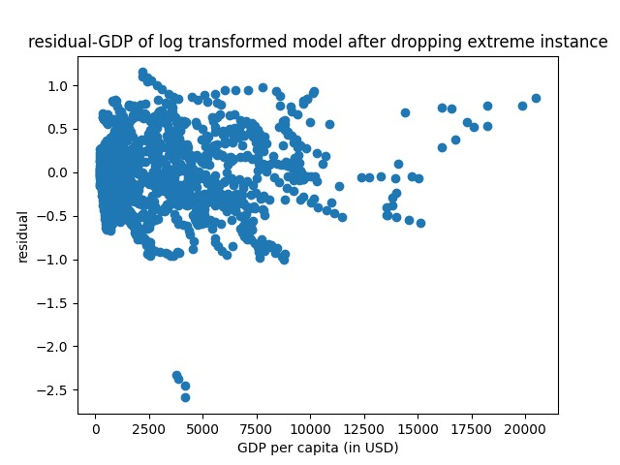

Slide 29
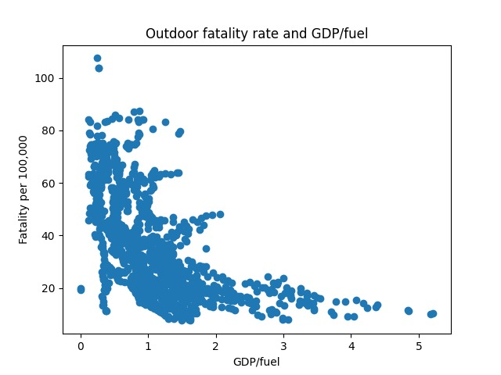
Some Correlation With Generated Feature

Slide 30
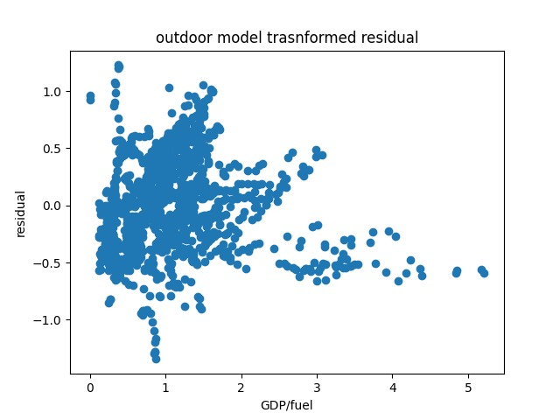
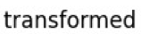
Residual of the Transformed Model with Generated Feature

Slide 31
Results
Best Model for indoor pollution with R^2 is 0.82
Best Model for outdoor pollution with R^2 is 0.51
Indoor model shows constant variance for residual
Outdoor model has a high regression, residual not constant where the GDP/Fuel ratio is high
This could induced by the small amount of observation data

Slide 32
Conclusion
For indoor pollution, the fatality rate shows as a function of exponential decay with clean fuel usage rate until the extreme high value. The value > 94%.
For outdoor pollution, the fatality rate shows some relation with GDP/fuel.

Slide 33
Suggestions
Indoor Pollution
Clean Fuel
Cook
Warm Up
Outdoor pollution
Energy Density
Industrial Production
Transportation

